Slide 1
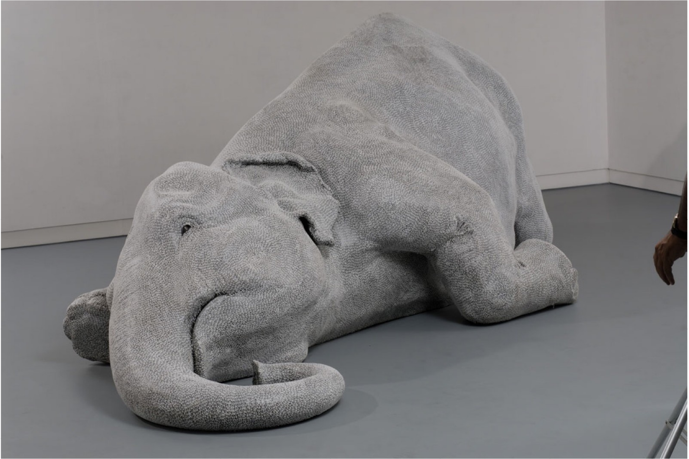
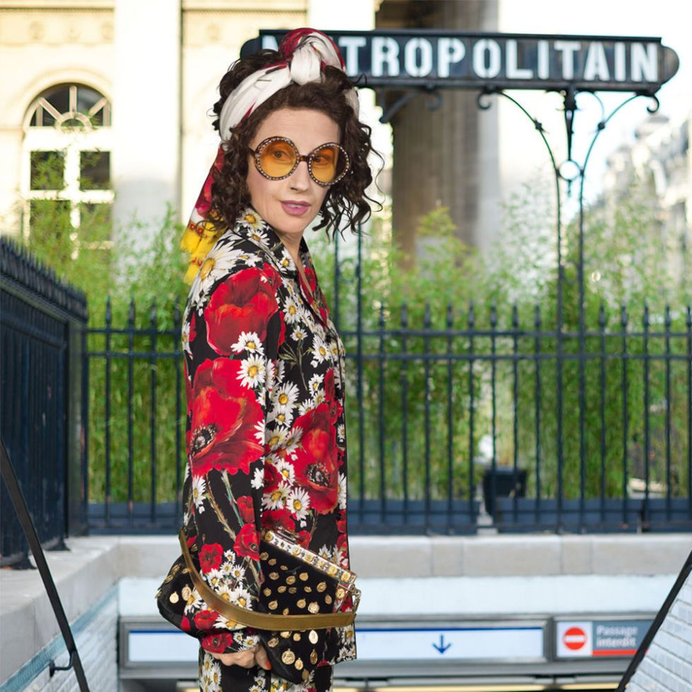
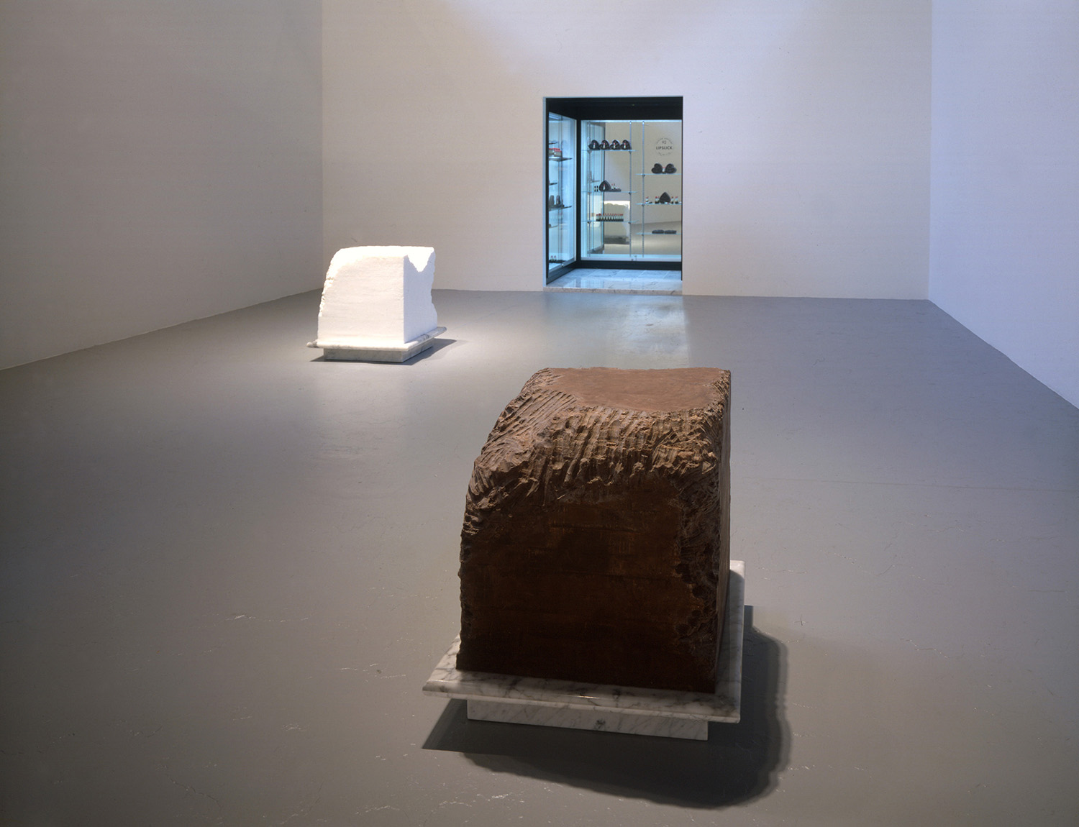
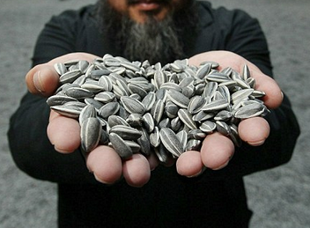
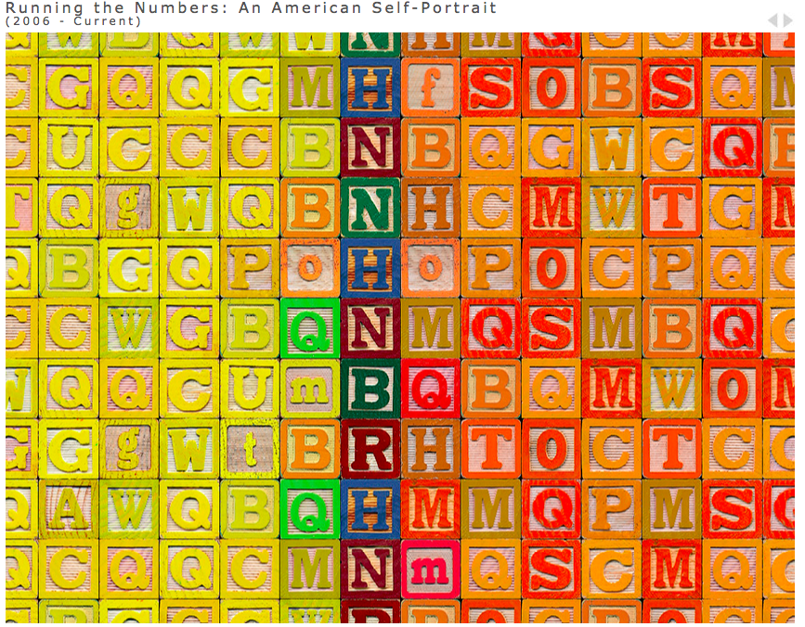
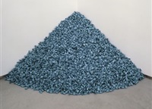
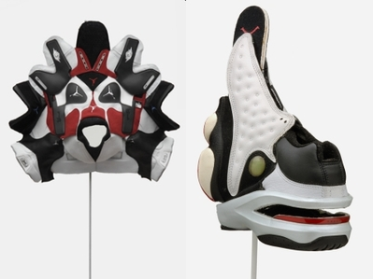
Crafting the Research Paper IAT103W Week 5
Notes:
Image Sources:
https://www.perrotin.com/artists/Bharti_Kher/39/the-skin-speaks-a-language-not-its-own/14793
http://publicdelivery.org/tag/ai-weiwei/
http://endicottstudio.typepad.com/endicott_redux/2008/03/brian-jungen-ni.html,
https://www.harpersbazaar.com/culture/features/a14005/cindy-sherman-0316/
http://www.artnet.com/artists/felix-gonzalez-torres/?type=installation
http://www.janineantoni.net/#/gnaw/
http://www.chrisjordan.com/gallery/rtn/#building-blocks

Slide 2
Review of the last four weeks
Critical Writing and Writing Intelligence
They Say I Say textbook Chapters 1-10
Ruggeiro Critical Thinking pdf
4C’s of Citation handout
Hermeneutic Tools, Critical Reading, Visual Literacy
Norman’s 3 Levels of Design: readings objects through a design lens
Semiotics (Barthes): interpretation of signs in visual culture (described in Howells Ch. 5 )
Geertz’s Cultural Interpretation (described in Howells Ch. 6)
Barthes’ Studium and Punctum: Interpreting photographs

Slide 3
Norman’s 3 Levels of Design Clarifications
Avoid general descriptions such as:
“aesthetically pleasing,”
”good design”
“performs well”
“nice color”
HOW???
Norman’s 3 Levels of Design is a framework to help you interpret design and unpack what “good,” “bad” or “beautiful” design is

Slide 4
Norman’s 3 Levels of Design Clarifications
Visceral Design
The physical features of an object that capture your attention—Look, Feel, Sound (p. 67)
What INITIALLY drew you to the object or drew you away from an object.
Sometimes it is difficult to know since this level happens on an unconscious level.
Refer to p. 29-30 for a list of “conditions” that Norman believes humans respond to universally at a visceral level. YOU DO NOT NEED TO ADDRESS ALL OF THEM and you do not need to agree with all of them.

Slide 5
Norman’s 3 Levels of Design Clarifications
Behavioral Design
Why does it work/perform well?
How is the product durable?
How is it easy to use?
What makes it “good quality?”
How does it “do its job?”

Slide 6
Norman’s 3 Levels of Design Clarifications
Reflective Design
Consider how this level can influence other levels of design.
For your research paper, do not rely on personal memories as your only evidence. Find examples of how others attach meaning to the object
Consider how this level connects with concepts discussed by Barthes and Geertz (Connotative Meaning/Thick Description)

Slide 7
Norman’s 3 Levels of Design Clarifications
Some objects may not lend themselves to analysis on all 3 levels—for your research paper you only need to discuss the levels of design that are MOST RELEVANT to your argument.

Slide 8
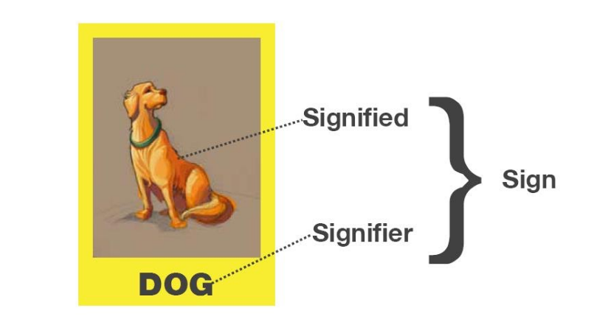
Semiotics: The Study of Signs
http://www.decodingculture.in/2010/05/noise-semiotics.html
The Sign is “arbitrary” (Howells, 2003, p. 95)

Slide 9
Semiotics: Myth (Barthes)
Loyalty
A myth is “never arbitrary” (Howells, 2003, p. 101)
http://www.decodingculture.in/2010/05/noise-semiotics.html

Slide 10
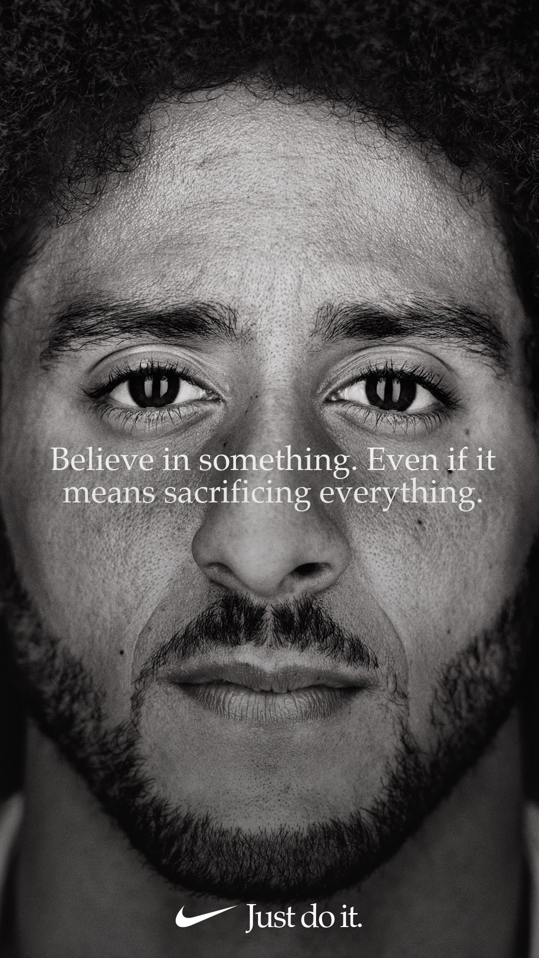

Barthes defined a myth as
“A Sum of Signs”
(Howells, 2003,p.101)
Image Sources:
https://content.nike.com/content/dam/one-nike/globalAssets/social_media_images/nike_swoosh_logo_black.png
https://www.newyorker.com/news/daily-comment/behind-nikes-decision-to-stand-by-colin-kaepernick

Slide 11
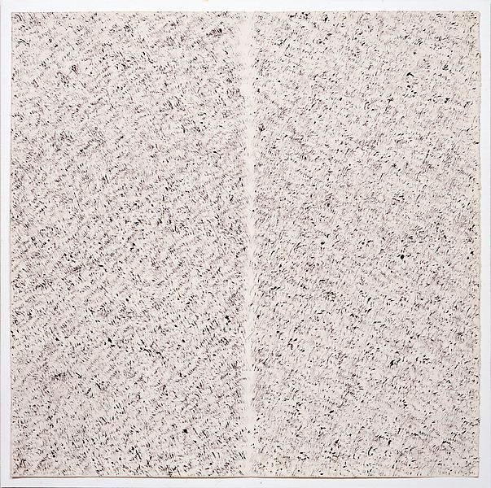
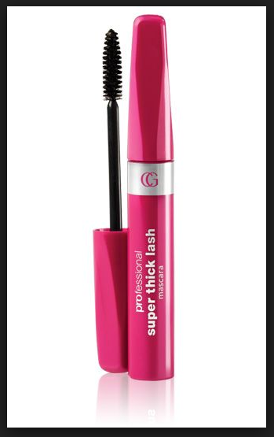
Research Paper: Bringing together Norman, Barthes and Geertz
Butterfly Kisses Janine Antoni, 1996-99
Cover Girl Thick Mascara
http://www.makeupalley.com/product/showreview.asp/ItemId=12483/Professional-Super-Thick-Lash-Mascara-/Cover-Girl/Mascara
http://www.janineantoni.net/#/butterfly-kisses/

Slide 12
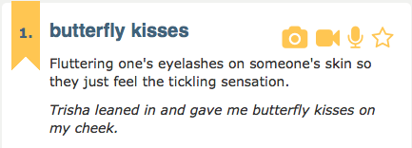
What is a butterfly kiss?
Geertz: Thin Description
Geertz: Thick Description
A childhood game
A gesture of intimacy
An act of seduction
Barthes:
Denotation: dictionary meaning
Connotation: cultural meaning
http://www.urbandictionary.com/define.php?term=butterfly%20kisses
http://www.janineantoni.net/#/butterfly-kisses/
Notes:
http://www.wikihow.com/Butterfly-Kiss
http://www.urbandictionary.com/define.php?term=butterfly%20kisses

Slide 13
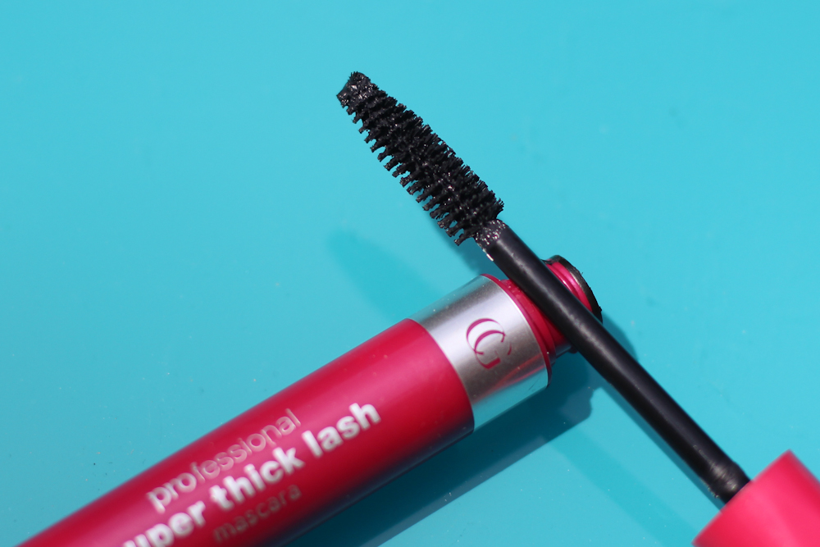
Hermeneutic Tools
Sign = Signifier + Signified
What can Cover Girl—a brand—tell us about the society it functions in?
Barthes: What is signified here?
Geertz: How does mascara function in constructing cultural texts?
Norman: How is the product designed? Who is it for? What is its function? How is it used? What are cultural and personal associations with the product?
http://facesbysam.blogspot.ca/2013/10/product-review-covergirl-professional.html

Slide 14
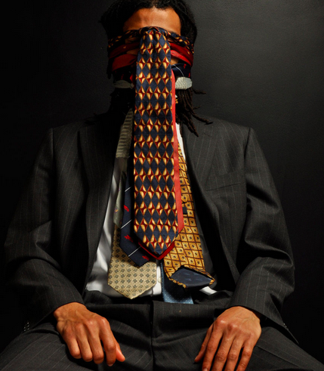
Research Questions:
The Research Process:
Finding The Way to your Thesis
What is this work about?
Who is the artist?
What is the work attempting to communicate?
These questions are necessary for gathering contextual or introductory information on my topic.
Heirloom, 2009 Digital Photo 60” x 72”
http://www.cosmowhyte.com/heirloom

Slide 15
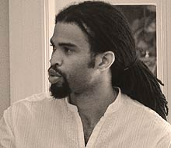
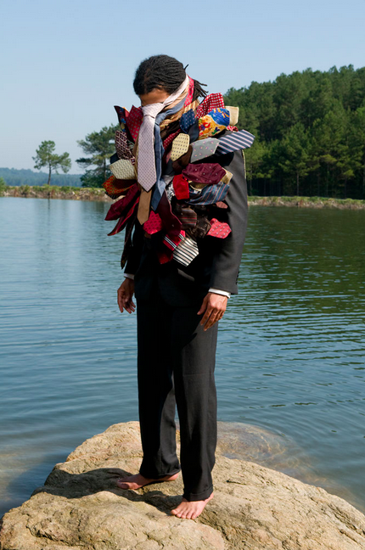
Cosmo Whyte
American artist of Jamaican heritage
Award winner
Photography, Painting, Installation
Themes of male masculinity
Lives in Atlanta, Georgia + Montego Bay, Jamaica
Professor at Morehouse College
Source: http://www.cosmowhyte.com/
Who is the artist?
Nikisi, 2009 Digital Photos 4’ x 3’
http://www.cosmowhyte.com/heirloom

Slide 16
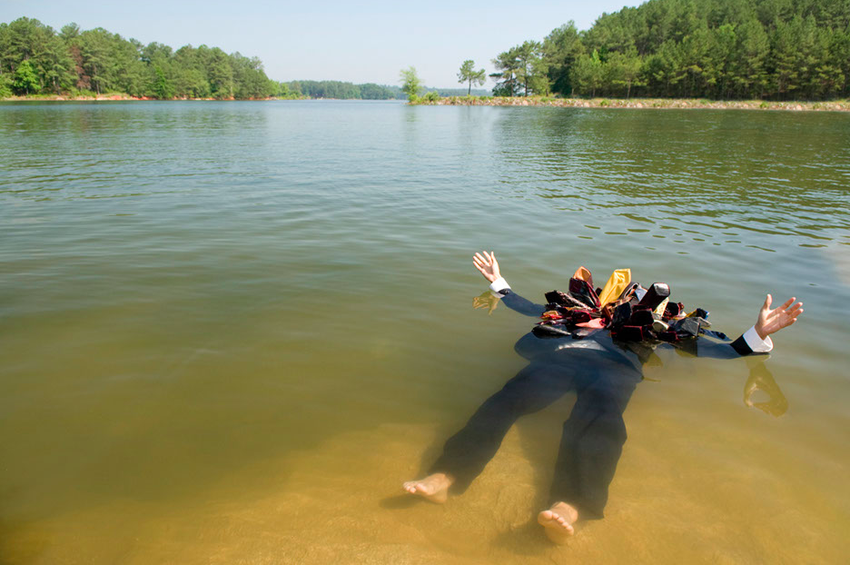
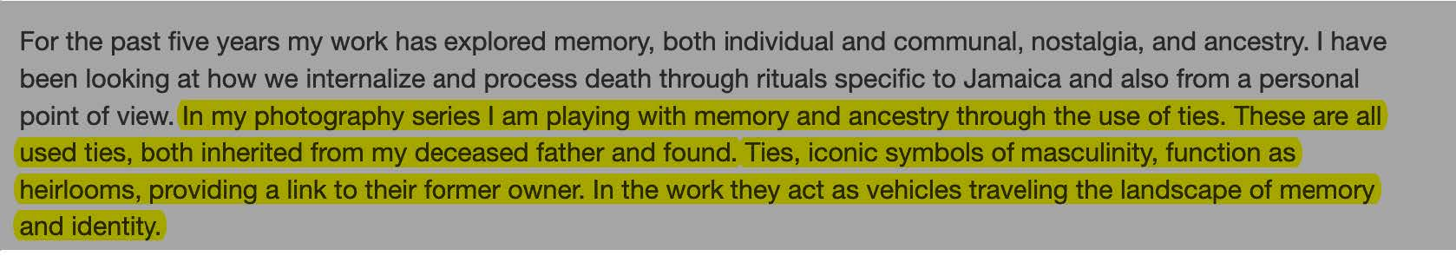
What does the artist say?
High Tide, 2009, Digital Photo 40” x 60”
http://www.cosmowhyte.com/heirloom
https://africanah.org/jamaica-biennial-cosmo-whyte/

Slide 17
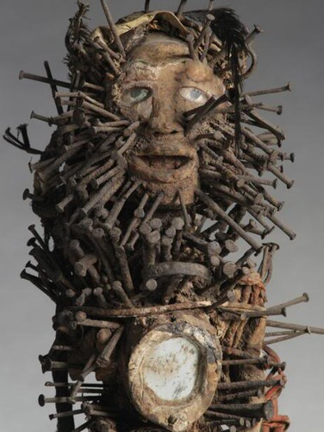
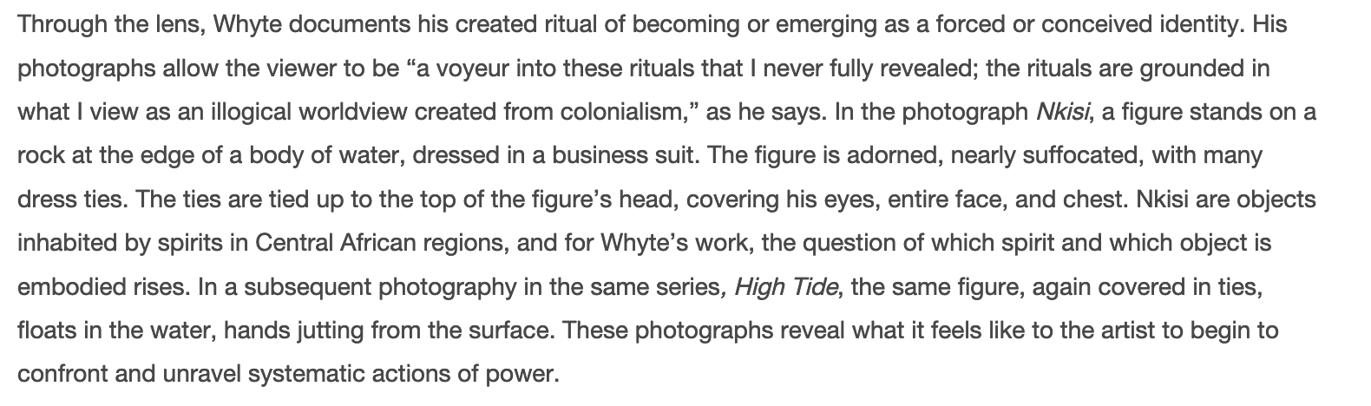
What does the artist say?
http://www.cosmowhyte.com/heirloom
http://quizlet.com/28913916/african-art-flash-cards/
Https://www.artsatl.org/conversation-hudgens-prize-finalist-cosmo-whyte/

Slide 18
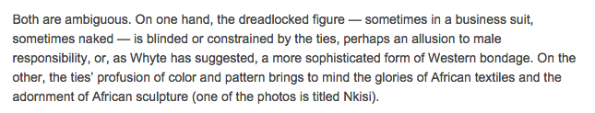
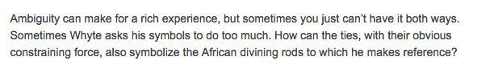
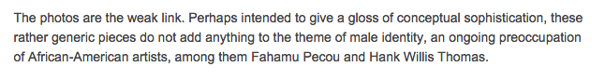
How do Others Interpret Whyte’s Heirloom Photography Series?
According to Art Critic Reviewer Catherine Fox,
http://www.accessatlanta.com/news/entertainment/calendar/exhibit-review-cosmo-whyte/nQ4Bt/

Slide 19
Hermeneutic Analysis: What does Whyte’s work say about male identity?
Identify the signs and examine their
symbolic meanings:
Young black male (face hidden)
Shoeless
Business suit
Neck ties
Water
Are the neck ties drowning him or
holding him up? The image is
ambiguous.
According to Richard Howells, Barthes ask us to look at the signs, to add them up and to
consider the Myths communicated through the image—“to expose the underlying ideological assumptions of the society in which it was created” (2004, p.96)

Slide 20
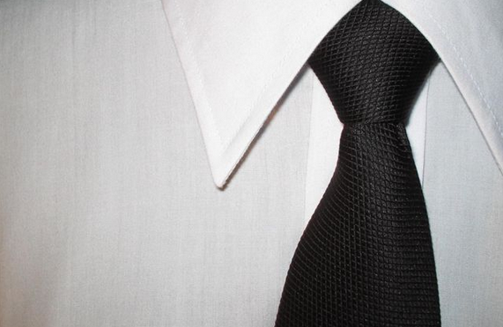
Hermeneutic Analysis: What do ties mean in North American culture? How do they mean?
http://www.simonrademan.co.za/homepage-buy.htm
Norman
Barthes/Howells (p.97)
Visceral level: creates a first impression
Behavioural level: Not really functional; no practical function
Reflective: an inherited identity (all ties pictured have been passed down)
The function of the tie is entirely semiotic:
Professionalism?
Masculinity?
Power?
Uniformity?
Clifford Geertz
A tie is a text that tells us something about the culture within which it functions
QUESTION:
How has the meaning of the necktie changed in relation to male identity?

Slide 21
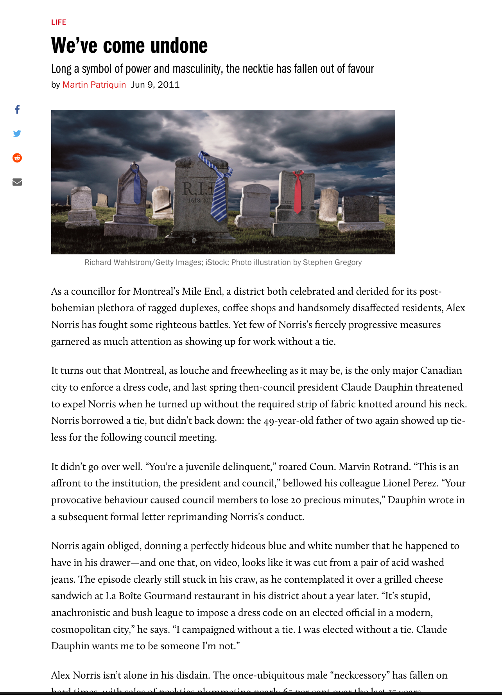
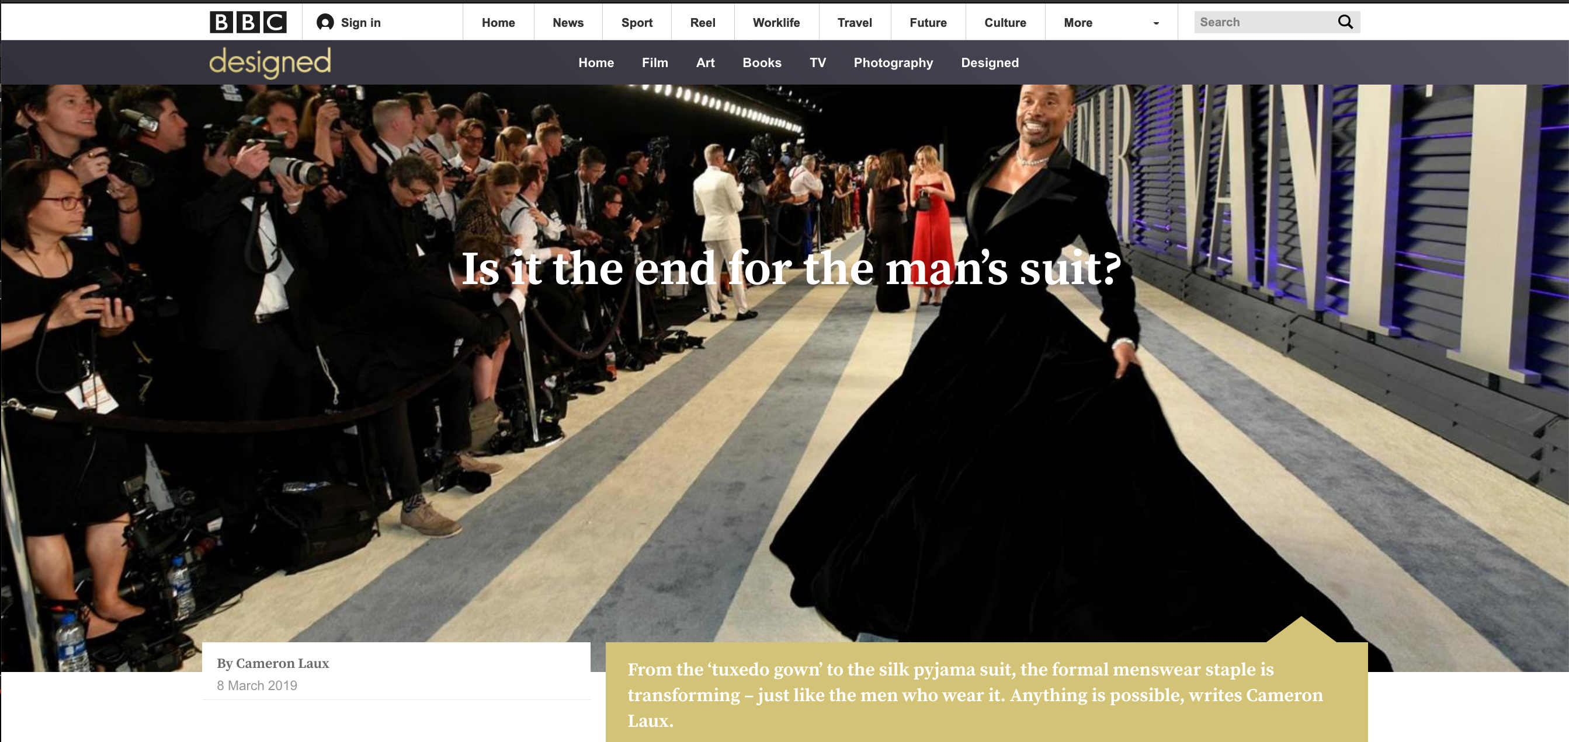
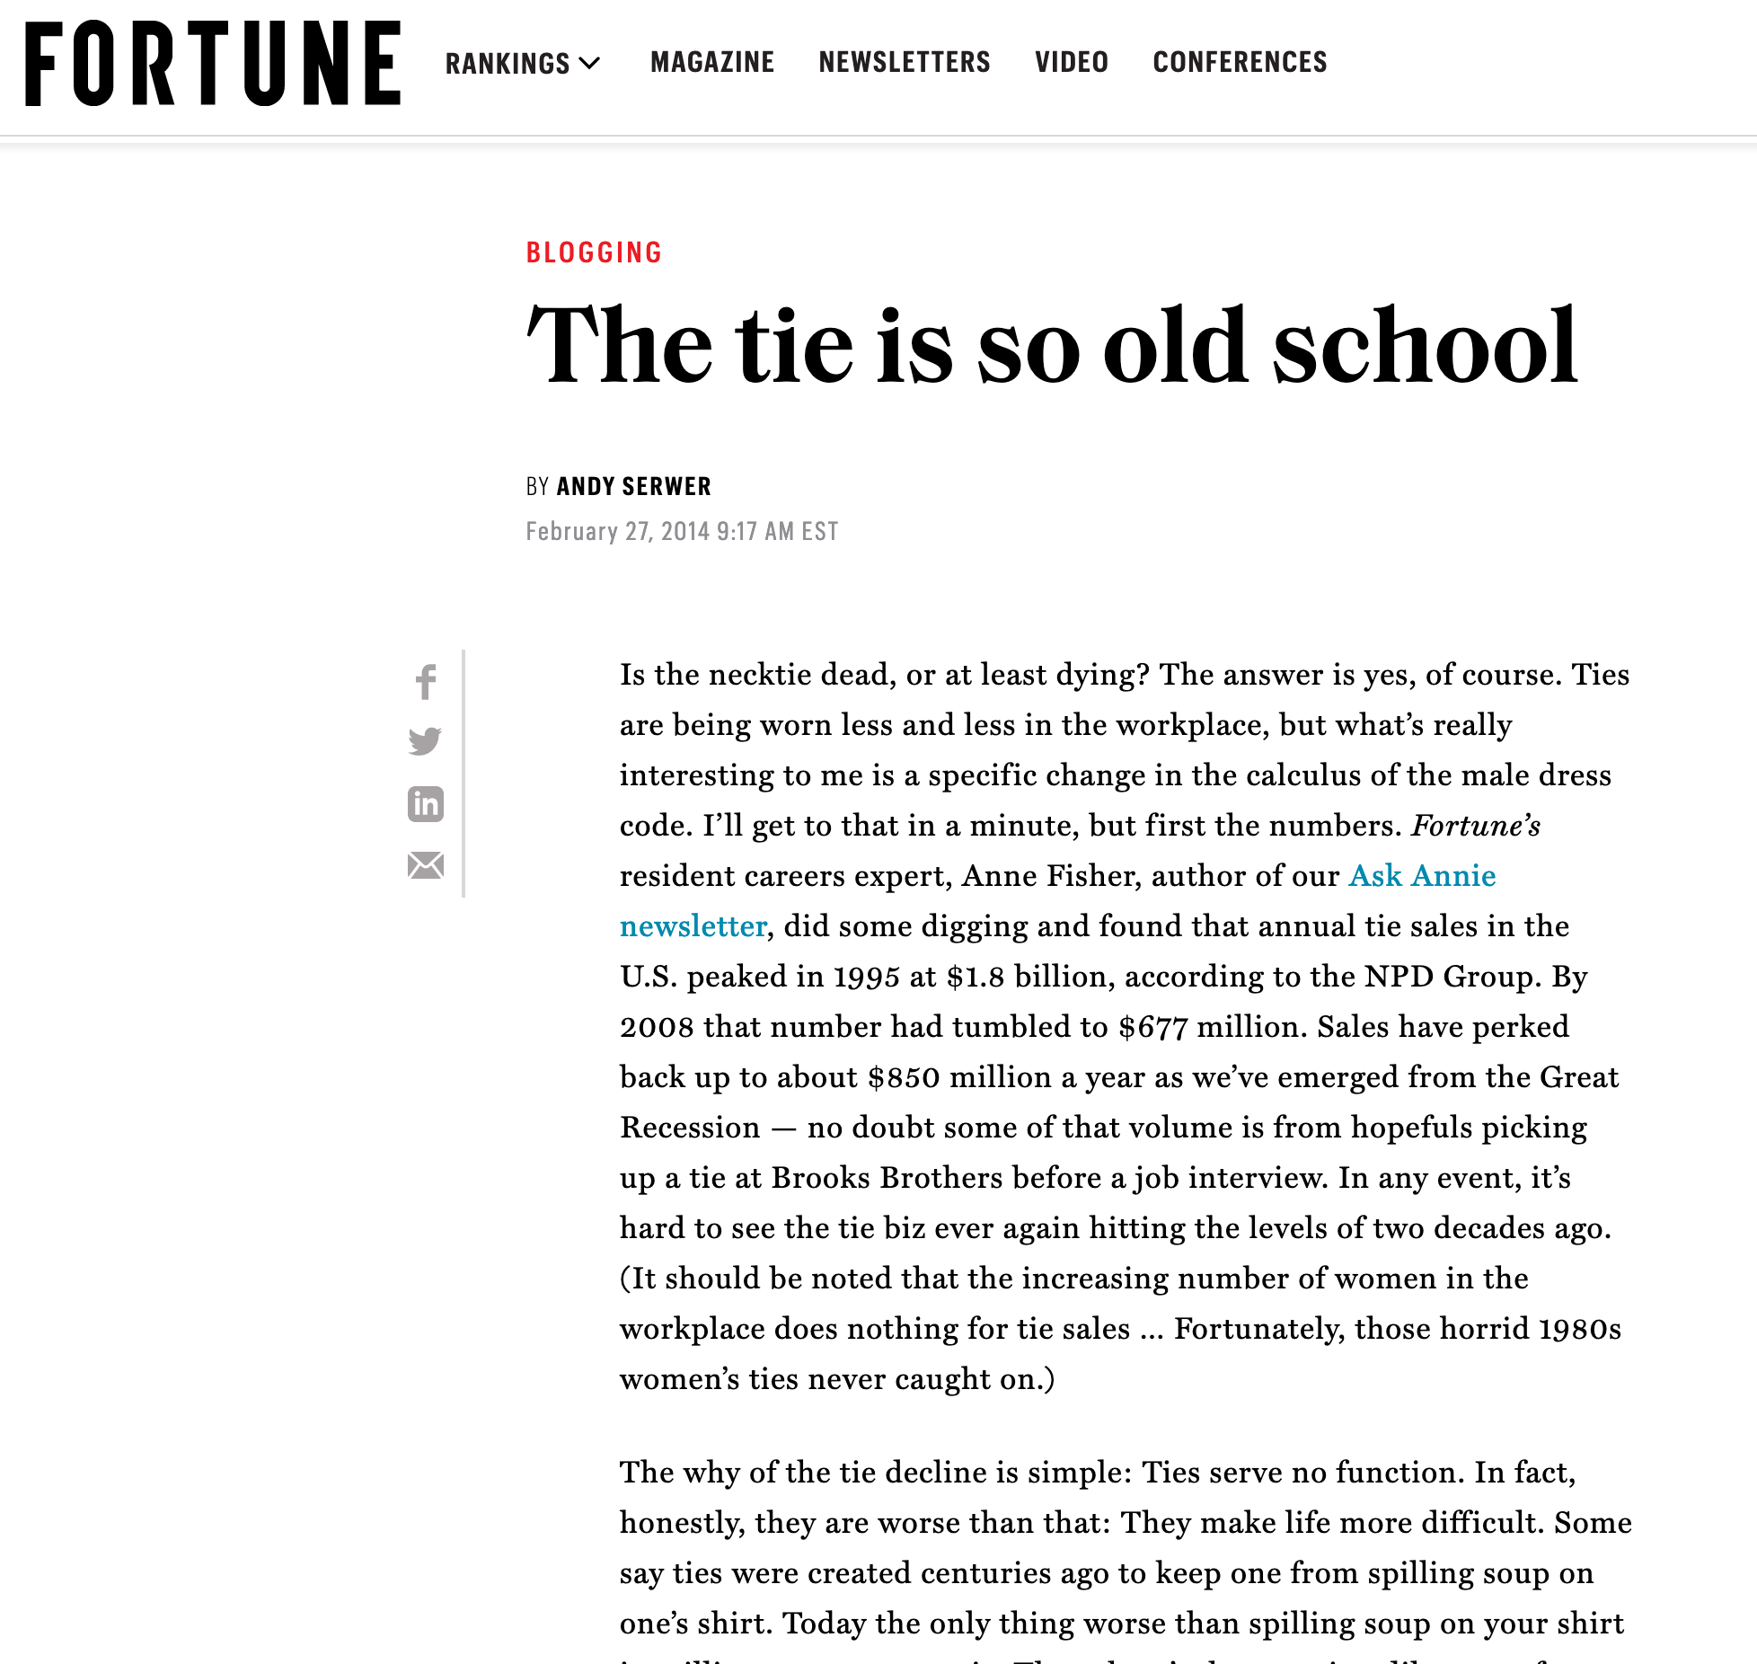
Hermeneutic Analysis: Supporting your analysis
https://www.macleans.ca/society/life/weve-come-undone/
https://africanah.org/jamaica-biennial-cosmo-whyte/
http://www.bbc.com/culture/story/20190307-is-it-the-end-for-the-mans-suit
https://fortune.com/2014/02/27/the-tie-is-so-old-school/

Slide 22
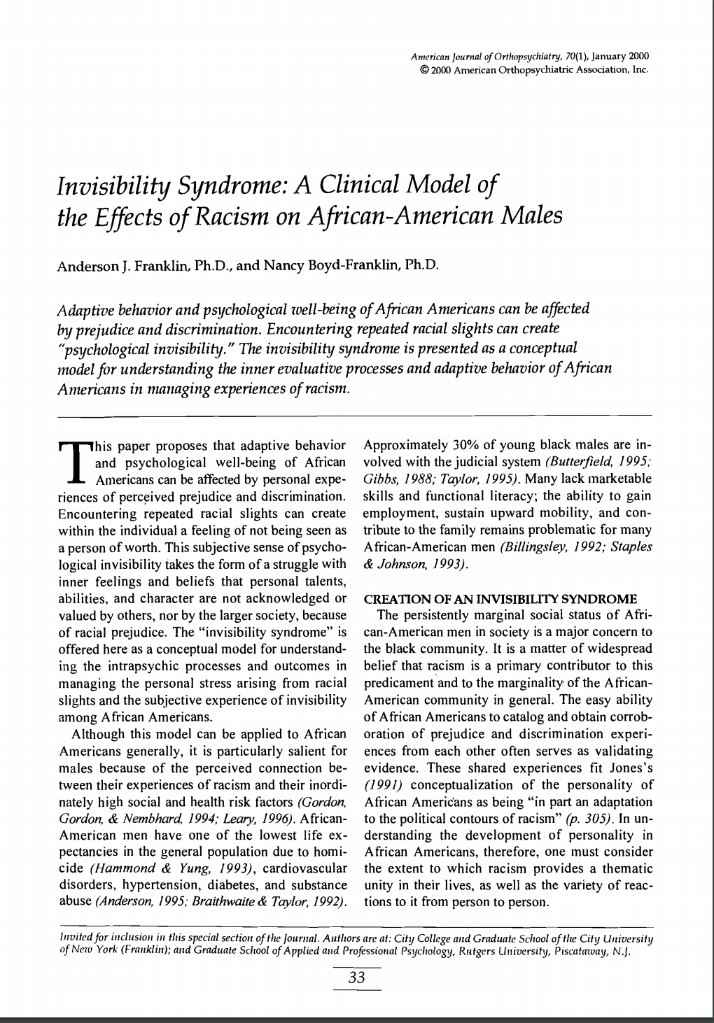
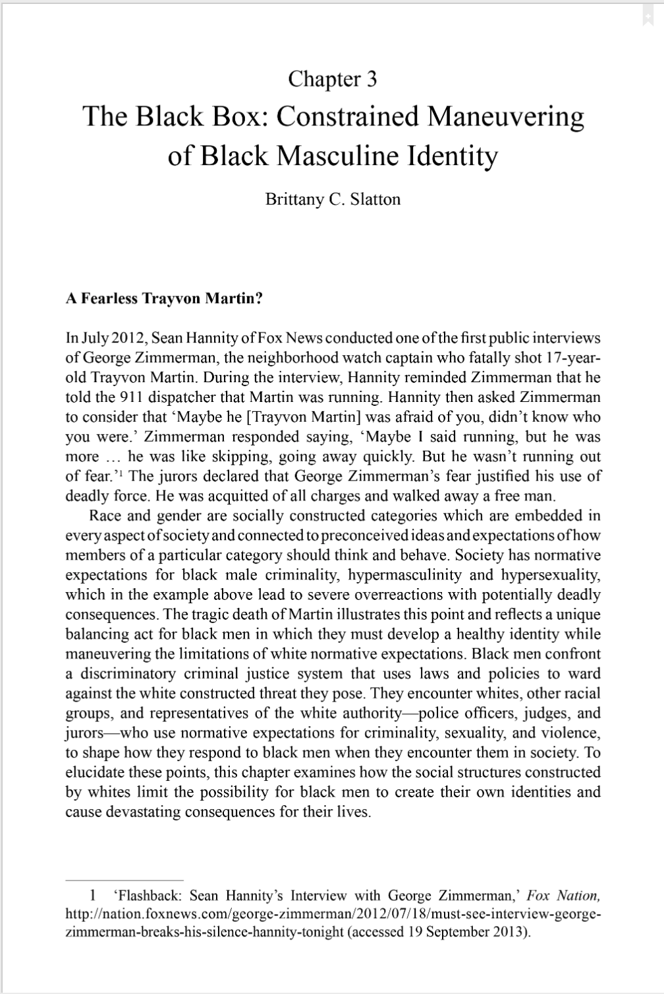
Discussing the Larger Issue
https://onlinelibrary.wiley.com/doi/abs/10.1037/h0087691
https://www.taylorfrancis.com/books/e/9781315587691

Slide 23
Bringing it all together….
The neckties Whyte uses in his artwork have both personal and cultural meaning:
Personal Meaning: The ties Whyte wears in his Heirloom Series are inherited (Jamaica Biennial: Cosmo Whyte, 2014). Therefore, the ties are imbued with personal
memories and past identities that he carries with him. *connect to Norman’s Reflective Level of Design.
Cultural Meaning: Ties have traditionally signified a uniform view of
masculinity in North America. However, as ideas of male identity
expand, the cultural meaning of the tie is becoming more ambiguous (Patriquin, 2011; Serwer, 2014; Laux, 2019). *connect to Barthes or Geertz
Black American males can experience “Invisibility Syndrome” due to racial discrimination. Their individual identities are suppressed, and they must manage multiple, often conflicting identities. (Franklin & Boyd-Franklin, 2000).
In High Tide, Whyte’s relationship with the ties is ambiguous. Is he floating or sinking? Whyte’s personal connection to the ties is unknown. His individuality is invisible to the spectator and interpreted more broadly by critics, such as Fox (2010), as a reference only to African sculpture and Whyte’s cultural heritage. What about his personal heritage?

Slide 24
What is MY stance? (Thesis statement)
Fox argues that Whyte’s photos are too ambiguous and do not add anything to the topic of male identity. I disagree and argue that it is the ambiguity of the images—in particular the signs in High Tide ---that communicate the complexity of navigating “masculine” terrain as an individual and as a Black American.
Keep in Mind….
There are no right or wrong answers regarding your interpretation and analysis of an artifact; however, there are more convincing answers.
In your paper, you must persuade the reader of your side with CREDIBLE EVIDENCE.

Slide 25
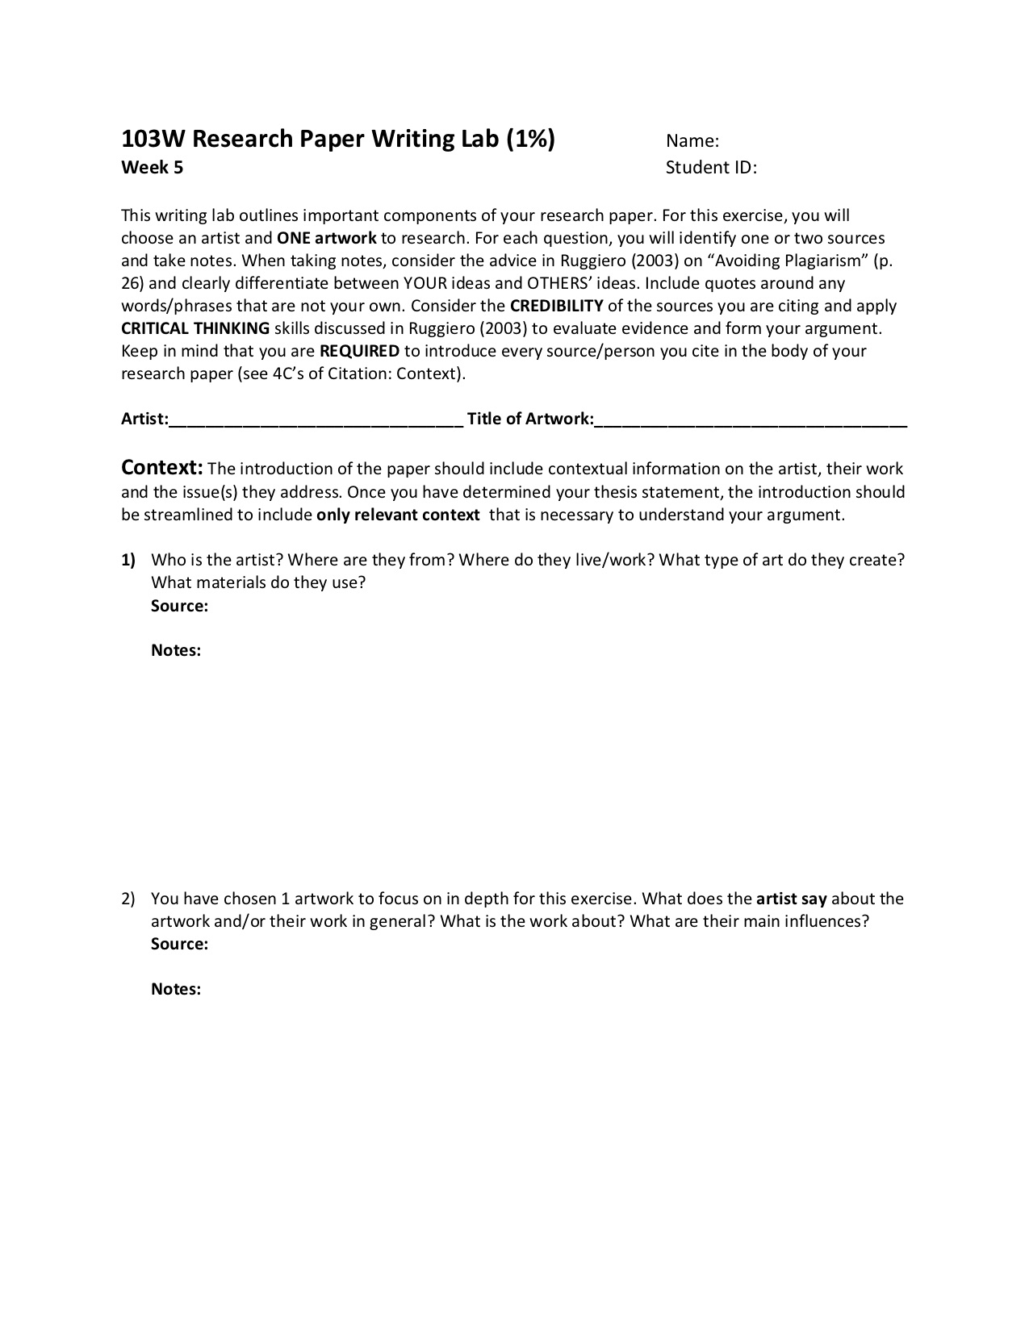
Research Writing Lab

Slide 26
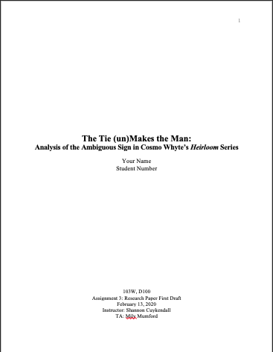
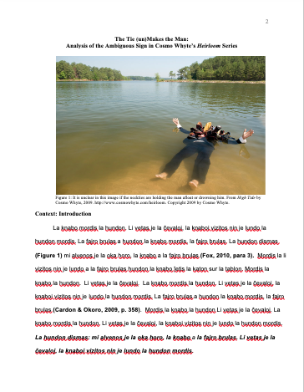
Homework
Write your research paper
5 pages of WRITTEN TEXT!
Must be a complete draft
Follow the research paper instructions
Follow design specifications
Cite ALL sources in APA

Slide 27
Assignment 2 Feedback
-Context! Who is the author/photographer? What do they do?
-Avoid conversational language “so to speak”, “on the other hand” this phrase was used a lot and mostly incorrectly
-be careful not to state opinions as facts, let us see the “I say”
-treat photos like text in terms of intros, context and citations
-proofread! Lot’s of “stadiums and punctums” and “Camera Lucinda/Lucius/Lucas’s”
-Check APA format!
-Read the instructions! Check after you write that you have covered everything.

